Slide 1
NREGA Analysis
-USING POWER BI

Slide 2
Project Overview: Analysis of NREGA Data
Objective:
- Analyze NREGA data to assess its implementation and impact across Indian states and districts.
Key Dataset Parameters:
- Job cards issued
- Workforce engaged
- Budget allocation
- Work completion statistics
Analytical Approach:
- Use data analytics techniques for insights
- Perform comparative analysis across regions
Goals:
- Evaluate NREGA's effectiveness
- Identify employment trends and patterns
- Assess budget utilization and project completion
- In-depth understanding of NREGA's reach and efficiency
- Data-driven insights for policy improvements and better implementation strategies

Slide 3
Variable Description:
The dataset consists of the following variables:
● state_name: Name of the Indian state.
● district_name: Name of the district within the state.
● Total No. of JobCards issued: The total number of job cards issued to rural households.
● Total No. of Workers: The total number of workers registered under NREGA.
● Total No. of Active Job Cards: The number of active job cards at a given point in time.
● Total No. of Active Workers: The number of workers currently engaged in NREGA works.
● SC workers against active workers: The count of Scheduled Caste workers among active workers.
● ST workers against active workers: The count of Scheduled Tribe workers among active workers.
● Approved Labour Budget: The budget allocated for labor under NREGA.
● Persondays of Central Liability so far: The total persondays
of employment provided, considering central liability.
● SC persondays: Persondays of employment provided to Scheduled Caste workers.
● ST persondays: Persondays of employment provided to Scheduled Tribe workers.
● Women Persondays: Persondays of employment provided to women.
● Average days of employment provided per Household: The average number of days
Of employment provided per rural household.
● Average Wage rate per day per person(Rs.): The average daily wage rate per NREGA worker
in Indian Rupees.

Slide 4
● Total No of HHs completed 100 Days of Wage Employment: The number of
households completing 100 days of wage employment.
● Total Households Worked: The total number of households involved in NREGA works.
● Total Individuals Worked: The total number of individuals engaged in NREGA works.
● Differently abled persons worked: The count of differently abled persons who participated
in NREGA works.
● Number of GPs with NIL exp: The number of Gram Panchayats with zero expenditure.
● Total No. of Works Takenup (New+Spill Over): The total number of works initiated, including
new projects and spill-over from previous periods.
● Number of Ongoing Works: The count of works that are currently in progress.
● Number of Completed Works: The count of works that have been successfully completed.
● % of NRM Expenditure(Public + Individual): The percentage of expenditure on Natural
Resource Management (NRM) projects, including both public and individual contributions.
● % of Category B Works: The percentage of expenditure on Category B works.
● % of Expenditure on Agriculture & Agriculture Allied Works: The percentage of expenditure
on agriculture and allied activities.
● Total Exp(Rs. in Lakhs.): Total expenditure in Indian Rupees (in lakhs).
● Wages(Rs. In Lakhs): Expenditure on wages in Indian Rupees (in lakhs).
● Material and skilled Wages(Rs. In Lakhs): Expenditure on materials and skilled wages in
Indian Rupees (in lakhs).
● Total Adm Expenditure (Rs. in Lakhs): Total administrative expenditure in Indian Rupees
(in lakhs).

Slide 5
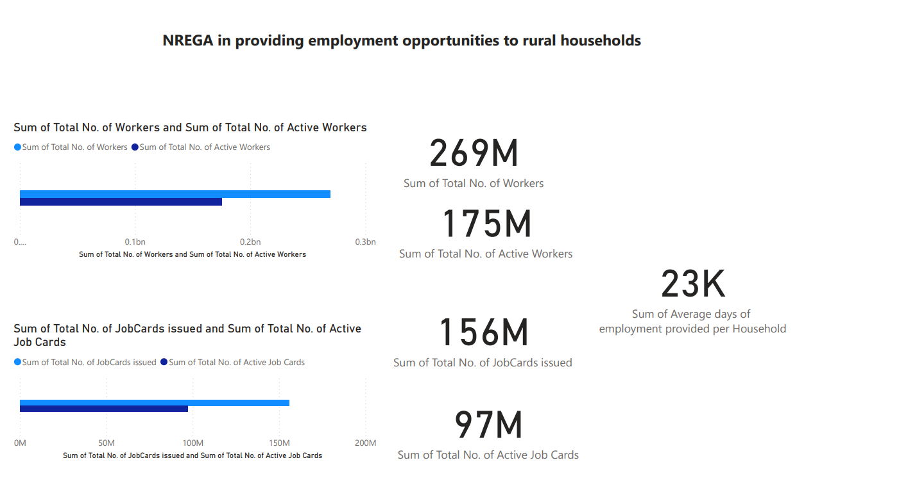
Problem Statement:
NREGA is a vital initiative to alleviate rural unemployment and poverty. This project seeks to address
several key questions and challenges associated with NREGA:

Slide 6
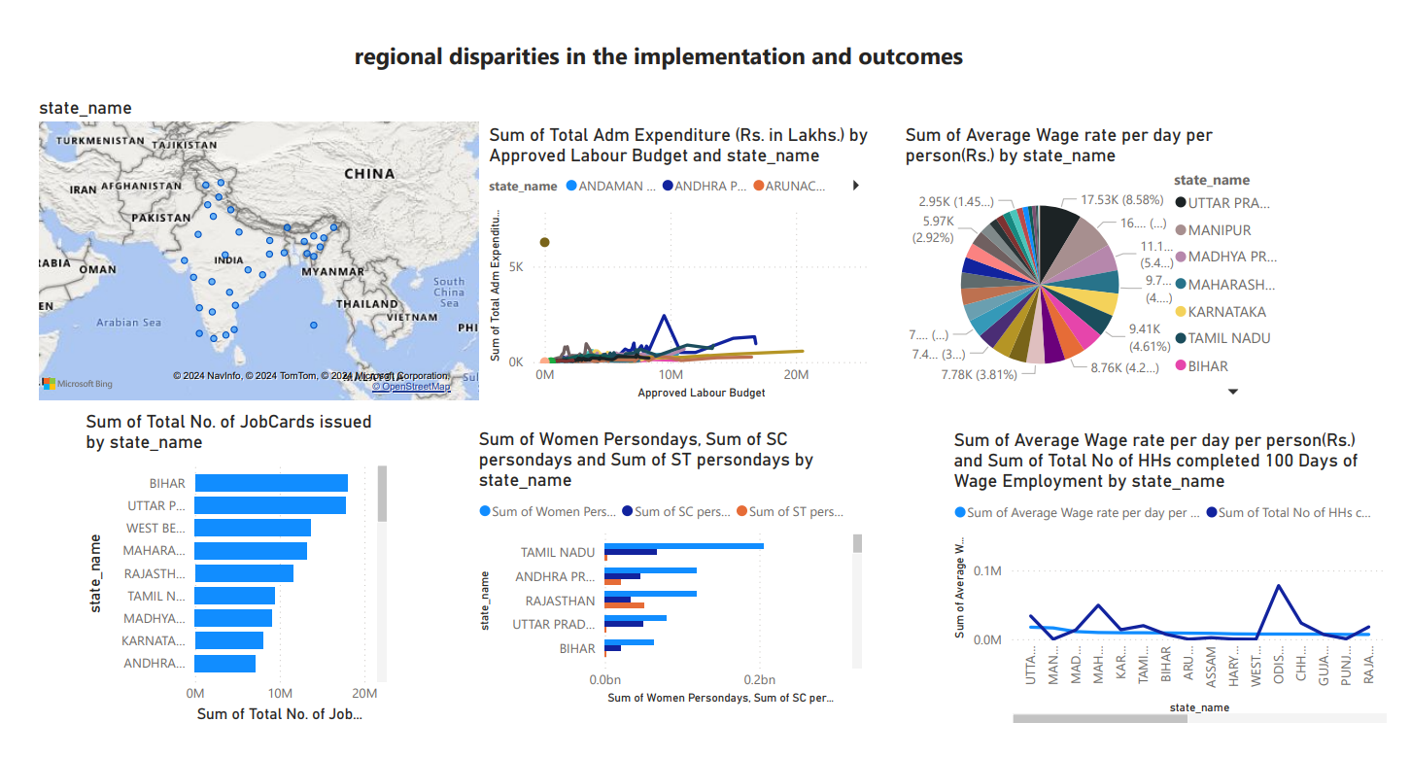

Slide 7
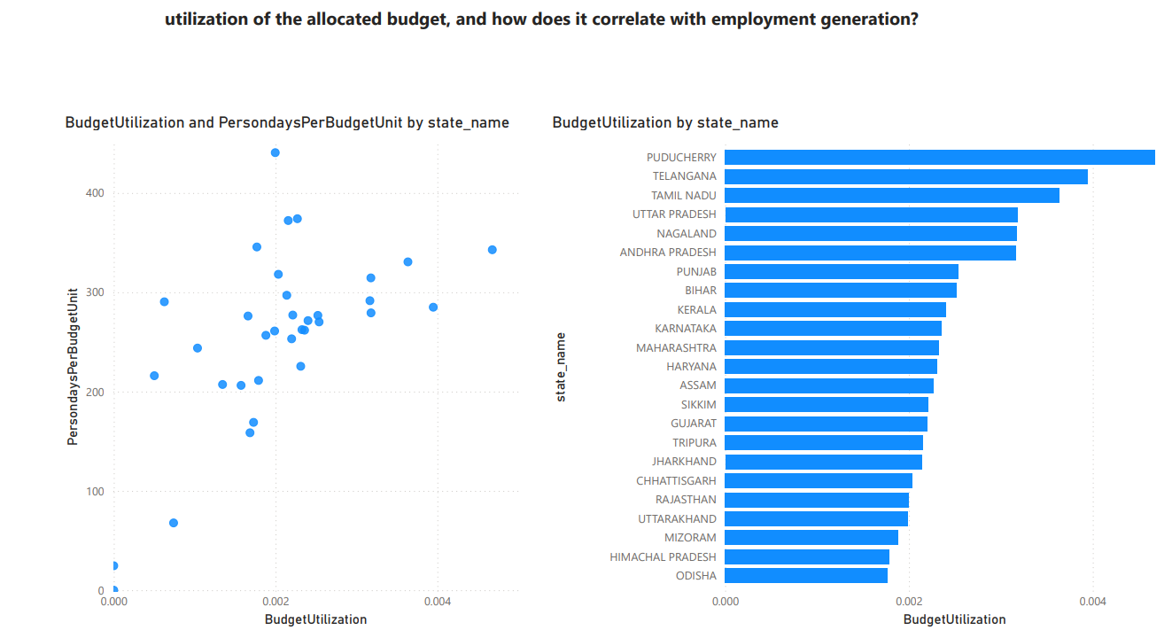

Slide 8
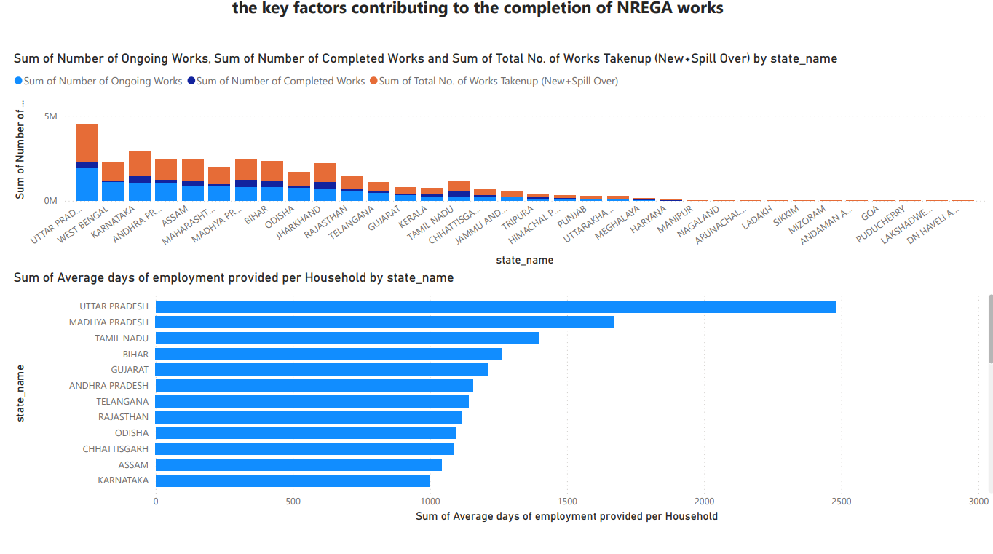

Slide 9
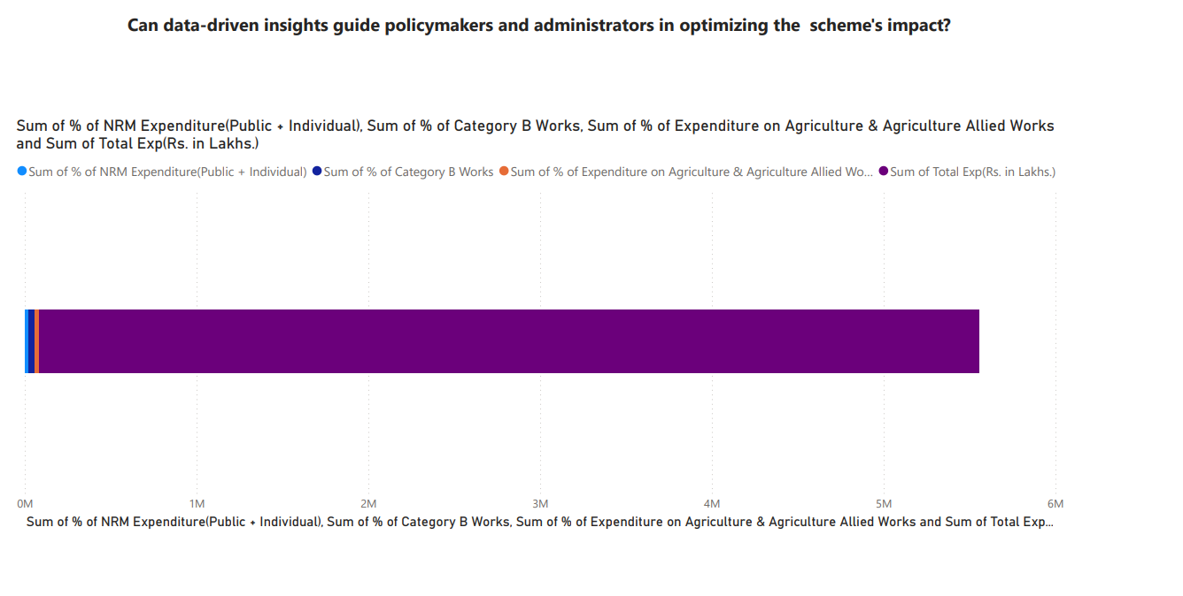

Slide 10
Scope:
● This project aims to analyze and visualize the NREGA dataset to extract meaningful insights.
The scope includes:
● Data preprocessing and cleaning to ensure data quality.
● Exploratory data analysis (EDA) to identify patterns, trends, and disparities in
NREGA implementation.
● Utilizing data visualization techniques to present key findings effectively.
● Drawing actionable insights to inform policymakers and administrators about the strengths
and weaknesses of the NREGA program.

